Slide 1
Ecphrastic poetry & the development of professional literacy in chemistry

Slide 2
What is ecphrastic poetry?
Ecphrastic poetry is the conversation between two pieces of art. The writer interprets a work of visual art and then creates a narrative in verse form that represents his or her reaction to that painting, photograph, sculpture or other artistic creation.
http://www.firkinfiction.com/11.html

Slide 3
Ecphrastic poetry and chemistry
How do you write a chemistry-related poem in an ecphrastic manner?
Complete the following steps:
View a stimulus image and identify a chemistry-related concept it evokes.
If required, write down the concept, definition, law, formula etc.
Identify a suitable poetry type and write the poem.

Slide 4

What concept does this image evoke?
http://www.wetcanvas.com/Community/images/19-Nov-2007/22284-frangipani.jpg

Slide 5
H₂O (droplets on flowers)

Slide 6
Example Haiku poem
Water molecules
have two hydrogen atoms
and one oxygen.
http://haikuprofessor.wordpress.com/2008/09/30/water-molecule/

Slide 7
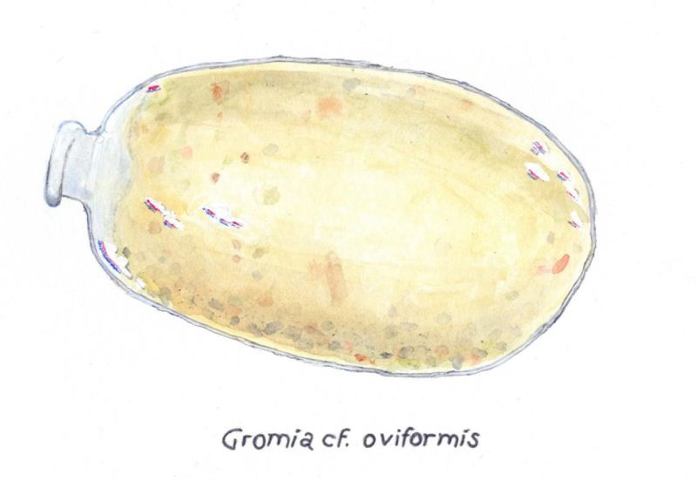
What concept does this image evoke?
http://icelines.blogspot.com/2011_06_01_archive.html

Slide 8
DNA/RNA sequencing of Gromia cf. oviformis

Slide 9
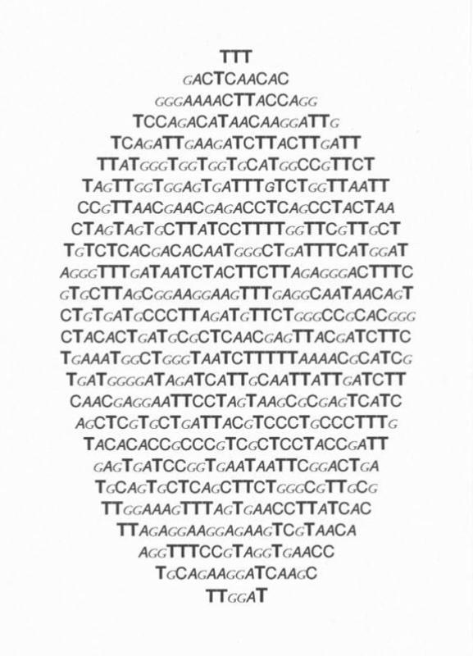
Example Concrete poem
http://icelines.blogspot.com/2011_06_01_archive.html

Slide 10
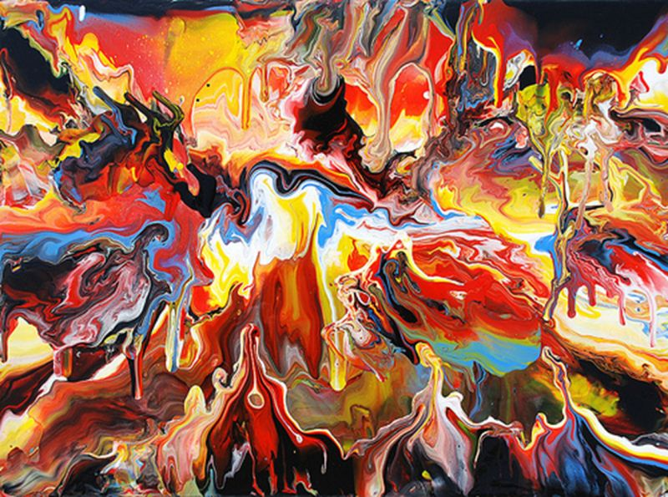
What concept does this image evoke?
http://farm5.static.flickr.com/4041/4673942347_7a52ee668b.jpg

Slide 11
Acid

Slide 12
Example Acrostic poem
Anions are used for naming purposes Corrosion can be removed through its use
Inorganic forms also occur
Dissociation constant is K_{a}

Slide 13
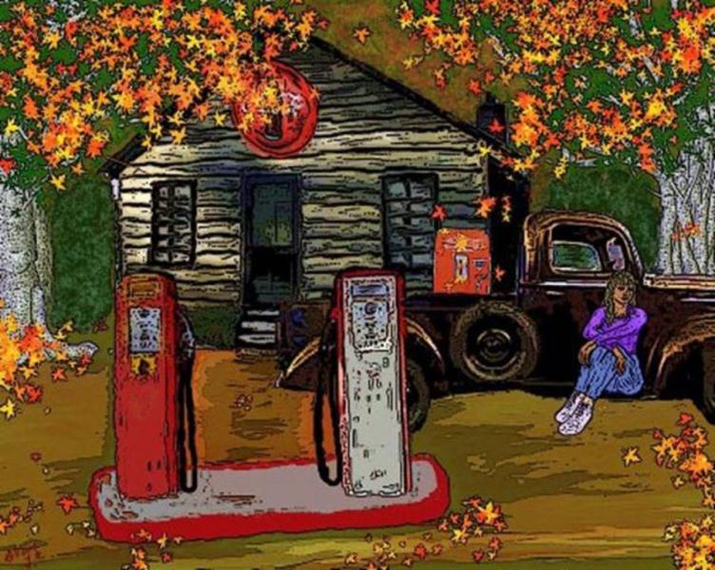
What concept does this image evoke?
http://images.fineartamerica.com/images-medium/old-service-station-glorie-tortoso.jpg

Slide 14
Hydrocarbons

Slide 15
Example Limerick poem
There once was a girl named Irene,
who lived on distilled kerosene.
But she started absorbin'
a new hydrocarbon,
and since then has never benzene!
http://www.freewebs.com/limericks/

Slide 16

What concept does this image evoke?
http://farm4.static.flickr.com/3116/2882683458_60465eeea3.jpg

Slide 17
Oxidisation (Rusting)

Slide 18
Example Free Verse poem
When iron goes, and oxidizes,
It gives us all a few surprises...
When ladder looks, a little rusted,
It really can't be, so well-trusted...
Rust corrodes, over time,
Might make ladder, bad to climb…
Rusty iron?
Not too strong, disintegrates, before too long...
http://sciencepoems.net/sciencepoems/rust.aspx

Slide 19
Example Free Verse poem
When iron’s reddish, it’s just rust,
Can turn some metal, into dust!
Yes, iron mixed with oxygen,
throw a little moisture in,
Oxidizes, makes it rust,
And rusty iron's, hard to trust…
http://sciencepoems.net/sciencepoems/rust.aspx

Slide 20
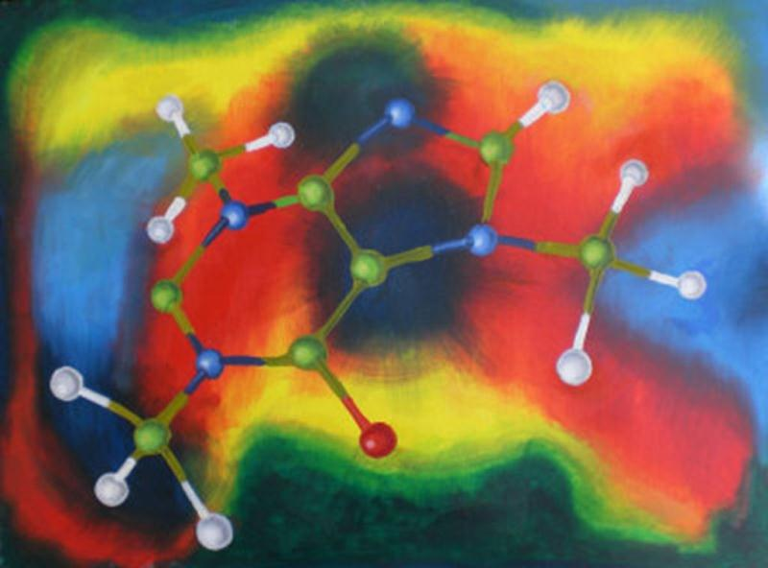
What concept does this image evoke?
http://imagecache.artistrising.com/artwork/lrg//3/371/QJW8000A.jpg

Slide 21
Molecular structure

Slide 22
Example Cinquain poem
Molecule
Small particle
Vibrates very quickly
Evokes excitement in my heart
Atom
http://answers.yahoo.com/question/index?qid=20110828163829AA4TmBn

Slide 23
What concept does this musical composition evoke?
I‘m a Lumberjack
(from Monty Python).

Slide 24
The chemistry profession

Slide 25
Example re-worked song lyric
I'm in chemistry and I'm okay, I sleep all night and I work all day.
He's in chemistry and he's okay, he sleeps all night and he works all day.
I clean my flasks, I read my JACS, I do reactions well.
He cleans his flasks, he reads his JACS, he does reactions well.
Someday I'll be unlucky and blow myself to Hell.
Someday we'll all be lucky and watch him blown to Hell.
* JACS = Journal of the American Chemical Society
http://jcdverha.home.xs4all.nl/scijokes/3_1.html#subindex

Slide 26
Activity
Using the given stimulus material, create the following types of poetry:
Free verse
Acrostic
Cinquain
Haiku
Limerick

Slide 27
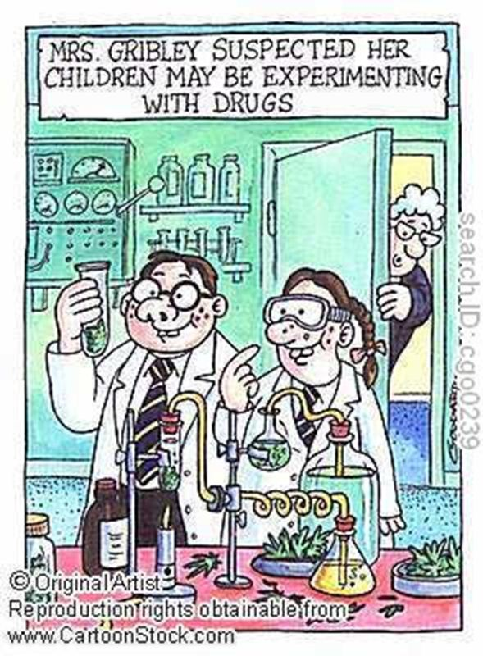
STIMULUS IMAGE 1
http://www.cartoonstock.com/lowres/cgo0239l.jpg

Slide 28
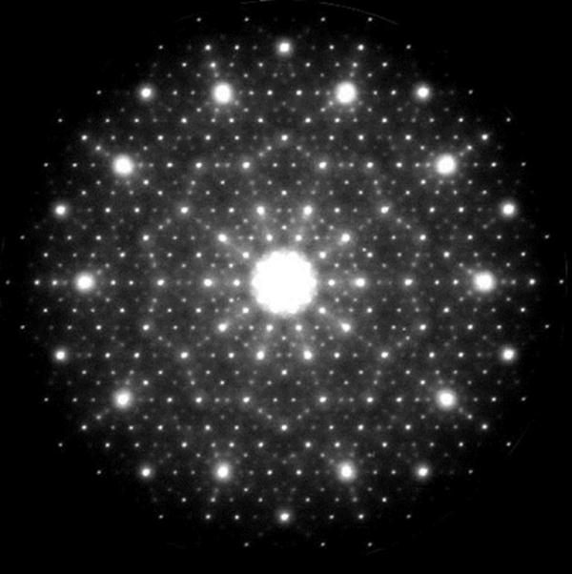
STIMULUS IMAGE 2
http://www.chemistryland.com/CHM151S/07-Atomic%20Structure/Spectra/ElectronDiffractionAlNiCo.jpg

Slide 29
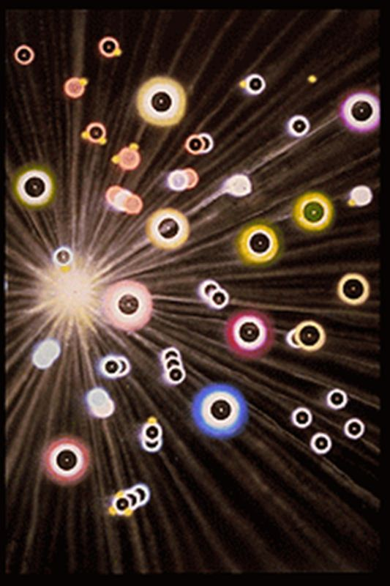
STIMULUS IMAGE 3
http://www.jonlomberg.com/images/digital_prints/dp_molecules_in_comets_tail_t.gif

Slide 30
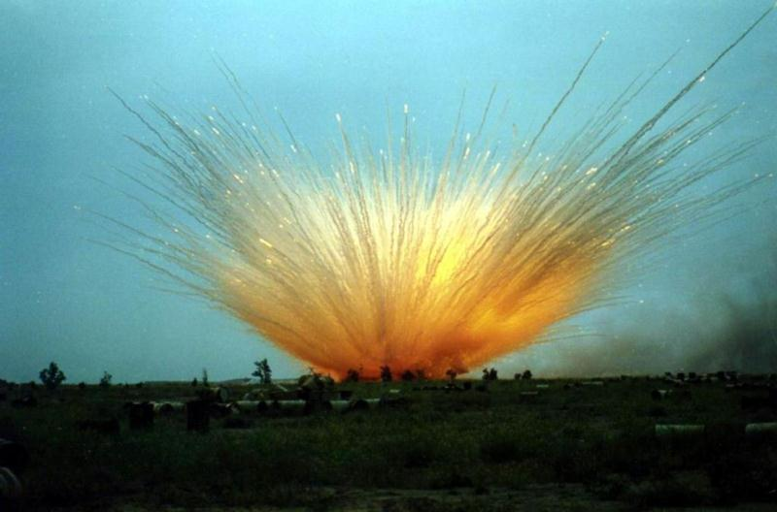
STIMULUS IMAGE 4
http://static.panoramio.com/photos/original/3042398.jpg

Slide 31
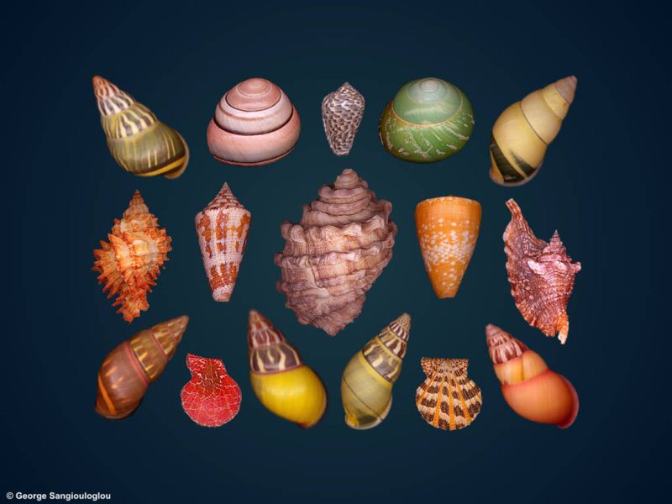
STIMULUS IMAGE 5
http://www.george-shells.com/wallpaper/shells_apr03dgr.jpg

